Slide 1
LENDING RISK MANAGEMENT CASE STUDY Gramener Case Study SUBMISSION
Group Name:
Hoshedar Mody
Kishore Kumar Poosa
Vivek Mohan Singh
Krishna Teja ( no contact and participation )

Slide 2
Abstract- For Lending Risk Management and Decision Support System
Why did you start? – To Minimize Risk of Lending
Two types of risks are associated with the bank’s decision:
If the applicant is likely to repay the loan, then not approving the loan results in a loss of business to the company
If the applicant is not likely to repay the loan, i.e. he/she is likely to default, then approving the loan may lead to a financial loss for the company
What did you do? – Analyses and Analytics – Helping to make risk free or minimal risk Decisions
Analyzed and cleaned data to formulate the edifice of Lending Risk Management
The data contains the information about past loan applicants and whether they ‘defaulted’ or not. The aim is to identify patterns which indicate if a person is likely to default, which may be used for taking actions such as denying the loan, reducing the amount of loan, lending (to risky applicants) at a higher interest rate, etc.
In this case study, we use EDA to understand how consumer attributes and loan attributes influence the tendency of default.
Plotted Graphs and isolated the Potential Risk bearing prospective borrowers of the Loans
In other words, borrowers who default cause the largest amount of loss to the lenders. In this case, the customers labelled as 'charged-off' are the 'defaulters'.
If one is able to identify these risky loan applicants, then such loans can be reduced thereby cutting down the amount of credit loss. Identification of such applicants using EDA is the aim of this case study.
In other words, the company wants to understand the driving factors (or driver variables) behind loan default, i.e. the variables which are strong indicators of default. The company can utilise this knowledge for its portfolio and risk assessment.
What did you find?
Considering that Spark Funds wants to invest between 5 to 15 million USD per investment round, the investment type most suitable is Venture Funds
Top English speaking country is USA followed by Great Britain and India

Slide 3
For Lending Risk Management and Decision Support System
What does it mean?
If the applicant is likely to repay the loan, then not approving the loan results in a loss of business to the company
If the applicant is not likely to repay the loan, i.e. he/she is likely to default, then approving the loan may lead to a financial loss for the company.
Critical analysis using EDA and visualizations

Slide 4
Lending Risk Decision Support Methodology
Format Clean Up
Ensure Valid Data format
Clean data to enhance quality and format of Data
Extraction and Transformation
Transformed raw Data into Analytical form
Extracted valid accurate data for Analysis
Analysis and Decision making
Performed Analysis on Data
Transformed Data into Visual Plots to facilitate decision making

Slide 5
Data Cleaning and Enhancing
Removed columns with more than 90% NAs
48 Columns used in the Study
Annual Income bucket slot - annual_income_slot
Interest Rate is a % which is converted to numeric absolute
Blanks in Employee Title were populated with ‘other’
Duplicates Checked ( id and member_id)
Removed Outliers based on Annual Income
Segmented Data based on loan_status

Slide 6
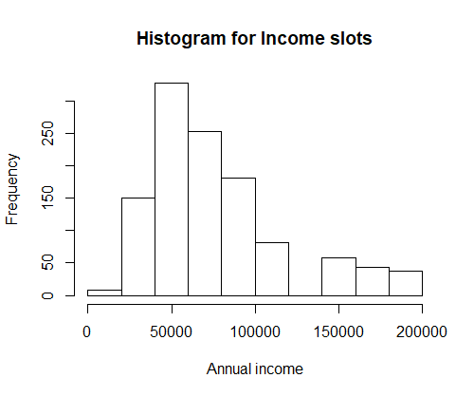
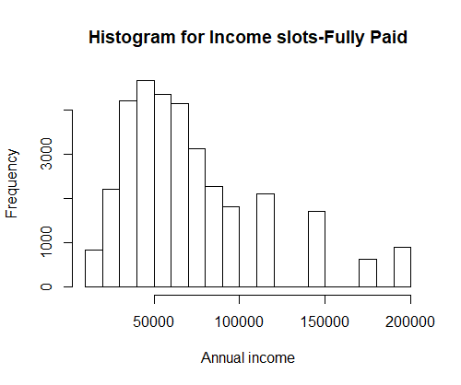
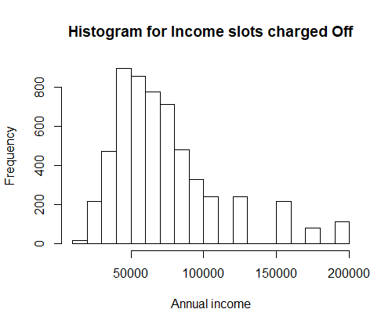
Annual Income range for each loan status
Annual income 30000 to 80000 are more number in terms of charge-Off and fully paid
63% of the charge off and 75% fully paid customers are concentrated in this region.
As the both are in the same region , we can’t conclude anything in this region
Current loan status customers are much concentrated between 40000 to 100000
This indicates investor showing interest to invest on customers in this annual income range

Slide 7
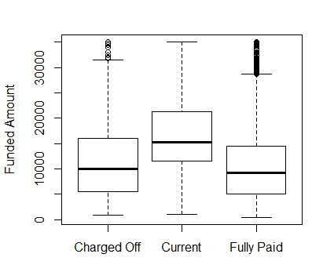
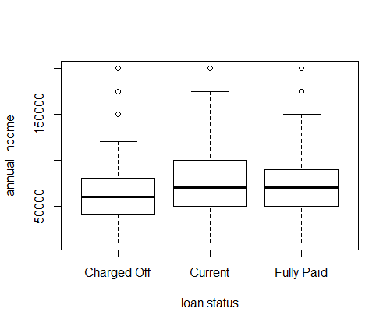

Slide 8
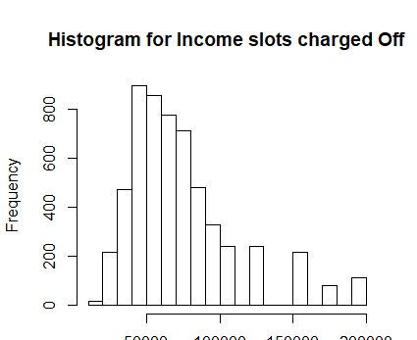
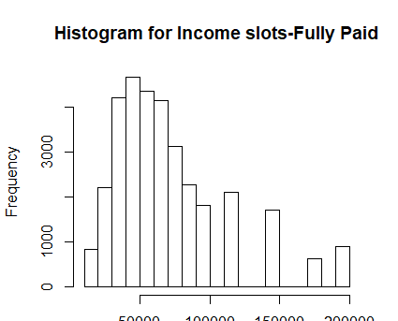

Slide 9
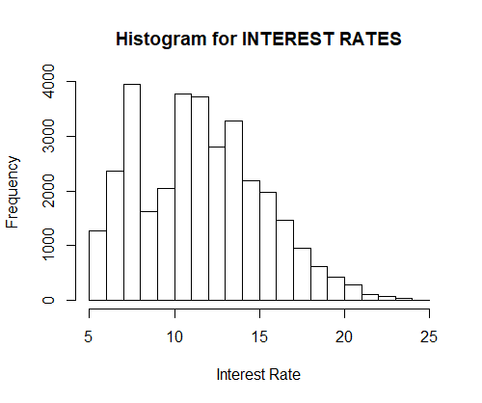
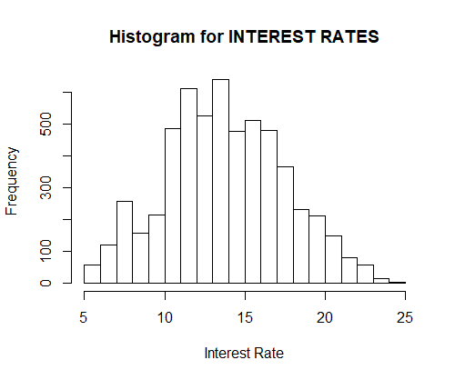
#Higher the interest rates higher the people chargeoff but we can't conclude this because we could see a mix.This could a catalyst.
Interest rate between 10 to 14 more charged off's exist
lower the interest rates people are tending to pay
Univariate analysis is giving us an idea on data but it is not driving us to conclusion.
Lets draw plots with multiple variables to understand the pattern

Slide 10
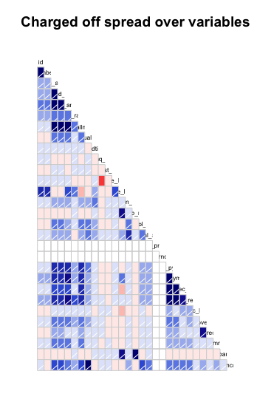
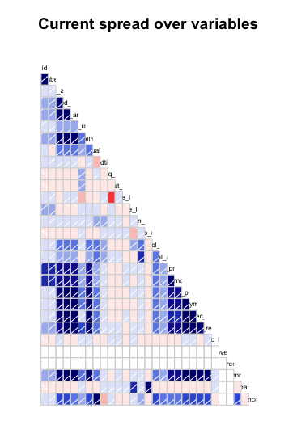

Slide 11
Charged Loans Univariate Risk Analysis – Funded Amount
In fully paid there are lots of high value loans and there is no problem fro the re-payment of the loan but the charged-off Loans and the ones which are not high-value loans
There is a correlation between Loan Amount and Funded-amount

Slide 12
Risk Analysis
 | Total Data Set | Charged | Fully Paid | Current
1. Total number of (count)
2. Average ( Mean )
3. Median
4. SD ( Standard Deviation )
5. 25 %
6. 50%
7. 75%
8. 100%
9.
10.

Slide 13
Univariate Risk Analysis
Annual Income Plots

Slide 14
Driving Factors
Emp Title , home_ownership , annual_inc --- most important one .. we must prove it suing correlation , Verification_status, purpose,loan_amnt, funded_amnt

Slide 15
Results through Plots

Slide 16
Visalization

Slide 17
<Results>

Slide 18
Results

Slide 19
<Conclusions>

